Slide 1
Chapter Two
Engineering drawing (DME 1102)
Chapter 2: Theory of Projections

Slide 2
1. Objectives
After this chapter, the students should be able to:
1. Recognize and sketch the symbol for first and third angle projection
2. List the six principal views of projection
3. Sketch the top, front, and right side views of an object with normal, inclined, and oblique surfaces.
4. Understand which views show depth in a drawing that shows top, front, and right side views.

Slide 3
2. Introduction
As we know that Engineering Drawing is the graphic representation of real things, ideas and proposed design.
An engineer must understand the fundamental principles or grammar of the language and must be able to execute the work with reasonable skill.

Slide 4
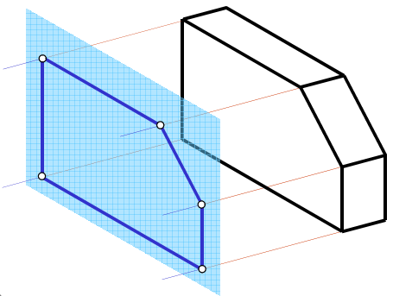
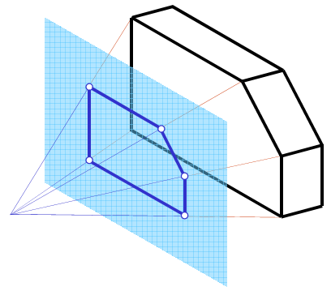
A. Projection: is the image of an object represented /drawn on a plane of projection/ picture plane as it would appear to the observer stationed at a point and viewing along the direction of line of projection.
B. Projector / line of projection: are an imaginary lines that emerges from observer’s eyes and moves to contour of an object. . It can be parallel or converge.

Slide 5
C. Station point: is the location of an observer.
D. Plane of projection / picture plane: is an imaginary plane on which the image of an object is represented /drawn. The plane on which principle view of an object is represented is called principal plane. The planes are assumed to expand infinitely and transparent.

Slide 6
Projection consists four components:
The actual object that the drawing or projection represents
The eyes of the viewer looking at the object
The imaginary projection plane (Viewers drawing paper)
Imaginary lines of sight called projectors

Slide 8
2.1. Principal plane
Here we have three principal projection planes.
Horizontal projection plane (H): is used to represent top or bottom view.
Frontal projection plane (F): is used to represent front or rear view.
Profile projection plane (P): is used to represent right or left side view of an object.

Slide 11
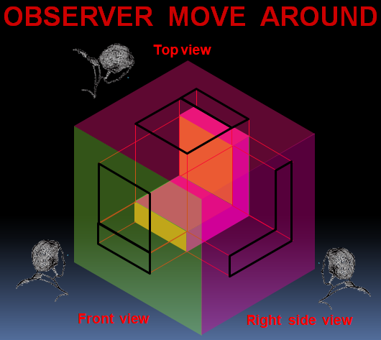

Slide 12
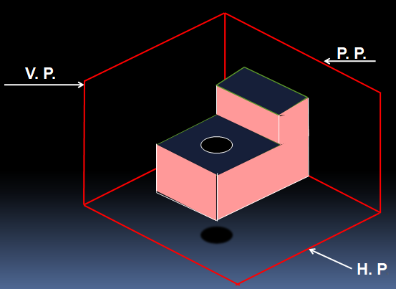

Slide 13
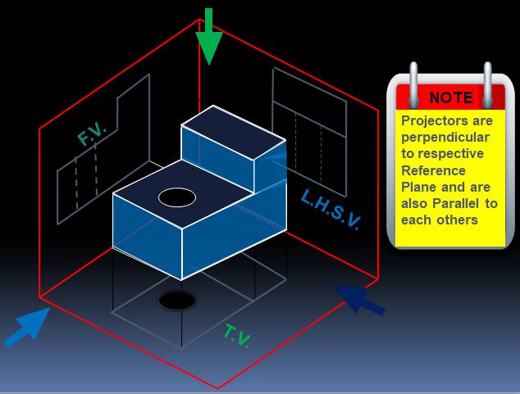

Slide 15
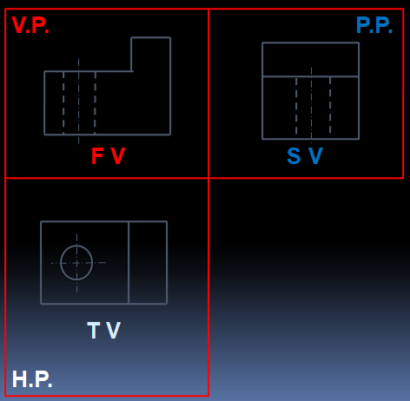

Slide 16
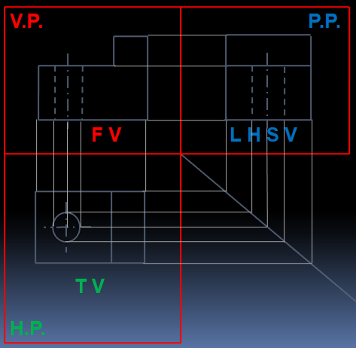

Slide 17
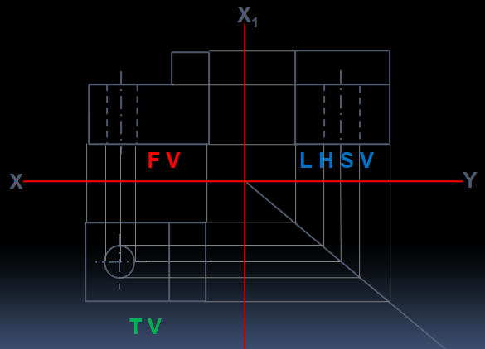

Slide 18
There are certain standard question that you must ask in order to create sketches.
For example, you need to know:
Which views to show?
How they should be oriented in your drawing?
How to represent key information? such as edges, surfaces, vertices, hidden lines center lines, and other crucial details.

Slide 19
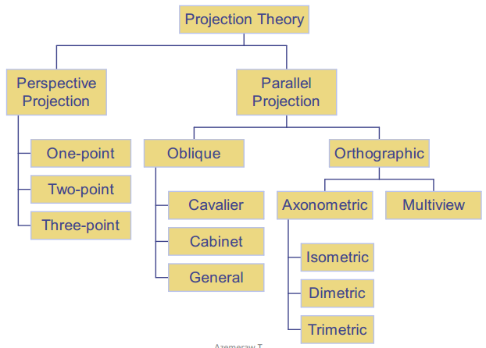
2.2. Types of projection: There are two main types of projection:

Slide 20
Perspective: offers the most realistic three dimensional view of all the pictorial methods.
Perspective sketches are visually accurate in that they look like what we see.
Objects farther away appear smaller than those that are closer.
The receding lines of perspective drawings converge to vanishing points that are located on a theoretical horizon.
The horizon is always located at eye level.

Slide 21
Objects above the horizon line are appear to be above, and objects below the horizon appear to be below.
Perspective drawings are often referred to as pictorial drawing.
Ordinary photograph we take by photo camera is a typical example of perspective projections.

Slide 22
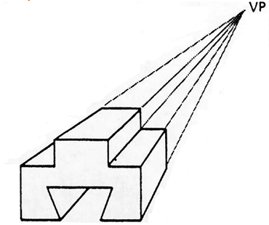
A. One point perspective projection: When drawing using one point perspective all objects vanish to a common point somewhere on the horizon.

Slide 23
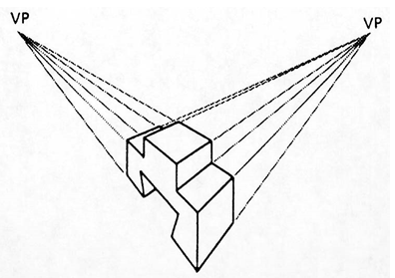
B. Two Points perspective projection: the object is placed so that one set of parallel edges is vertical and has no vanishing point, while the two other sets each have vanishing points.

Slide 24
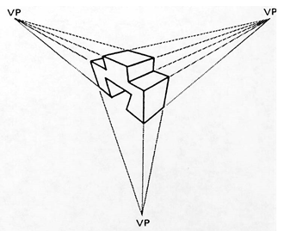
C. Three point perspective projection: the object is placed so that none of its principal edges is parallel to the picture plane. Hence, each of the three sets of principal edges will have a separate vanishing point.

Slide 25
2. Parallel projections: it is a projection where imaginary projection lines will not converge as a point on the viewer’s eye.
The projectors are parallel and do not meet.
The observer placed at an infinite distance from the object.
The view formed on the picture plane is of the same size and shape as that of the object.

Slide 26
There are two main types of parallel projection system elucidated below:
A. Orthographic projection
ORTHO means Perpendicular.
Observer is at infinite distance and rays or Projection lines are parallel to each other and Perpendicular to the Plane of Projection.

Slide 27
Since the projectors are perpendicular to the plane of projection, the view is called Orthographic View and the projection method is called Orthographic projection.

Slide 29
There are two types of orthographic projection
First angle projection:- the object is between the observer and the plane of projection (picture plane).
It is ISO standard and popular in Europe, Asia, and many other places.
Object is situated in the first quadrant.

Slide 30
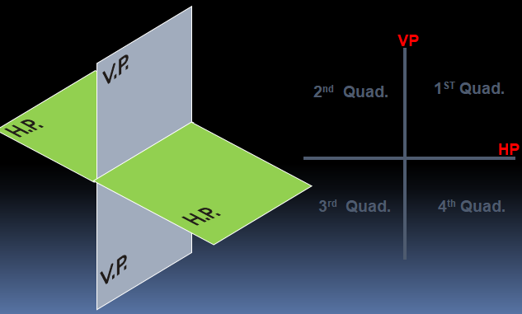
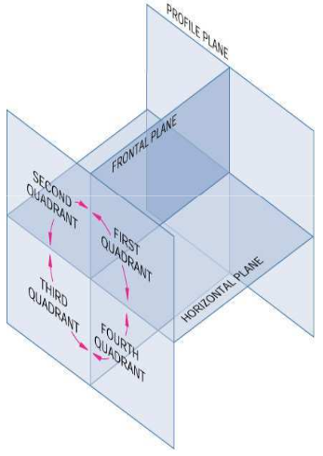
2. Third angle projection:- the plane is between the observer and the object. It is popular in USA, and Canada.
Object is situated in the third quadrant.

Slide 33
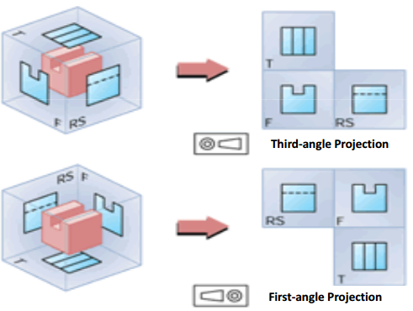

Slide 34
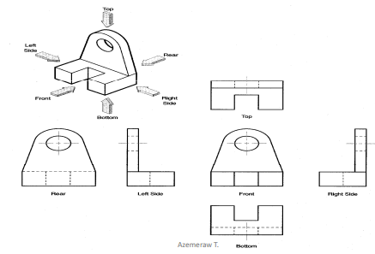

Slide 35
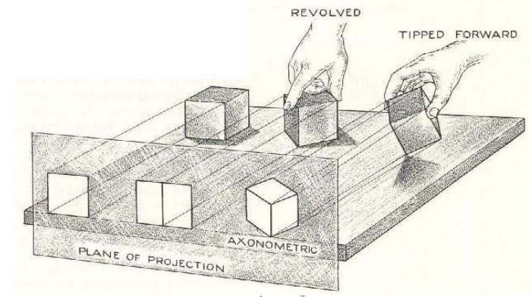
There are two types of orthographic projection
Axonometric projection: if the object is turned and tilted so that the three faces are inclined to the plane of projection is a special types of orthographic projection.

Slide 36
Note that, the projectors from the object to the plane are perpendicular to the plane.
Depending on the angles found between the principal projection planes, we can sub divide it into: isometric, diametric and trimetric projection.

Slide 37
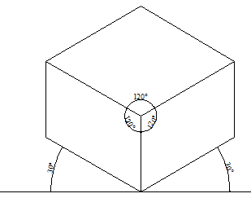
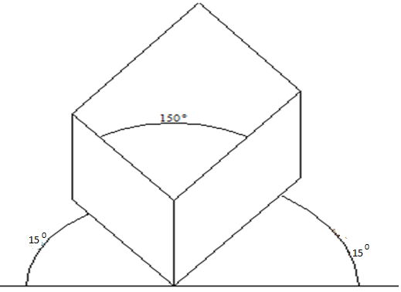
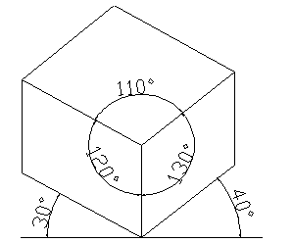
1. Isometric axonometric
2. Diametric axonometric
3. Trimetric axonometric

Slide 38
B. Oblique projections:- if the observer is considered to be stationed at an infinite distance from the object, and looking toward the object so that the projectors are parallel to each other and oblique to the projection.
The projector makes angle other than ${90}^{0}$ with that of the projection plane.
All faces of the object are visible in a single view.

Slide 39
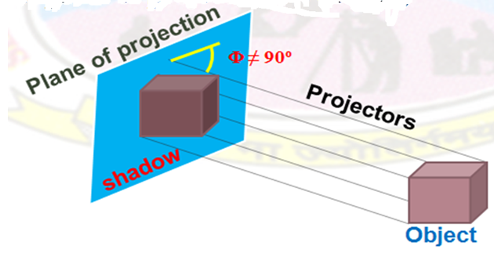
Rays or Projectors are not Perpendicular to the Plane of projection. (i.e. projectors are inclined to the plane of projection i.e. oblique)

Slide 40
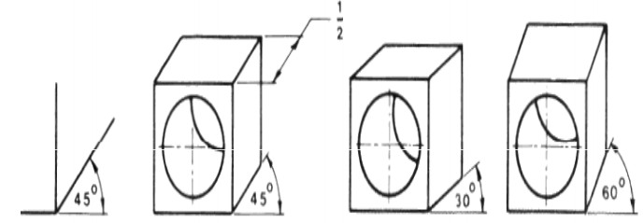
Front face sketched as a true shape. Starts with two axes, one horizontal, one vertical the third angle usually drawn by ${45}^{0}$, ${30}^{0}$ and ${60}^{0}$.

Slide 41
Projection of point

Slide 42
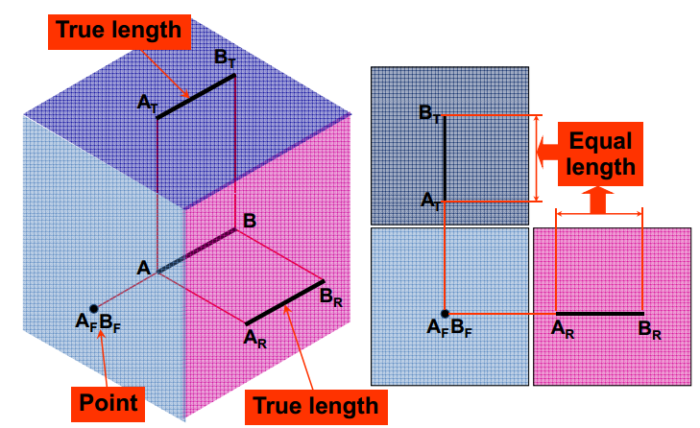
Projection of normal line

Slide 43
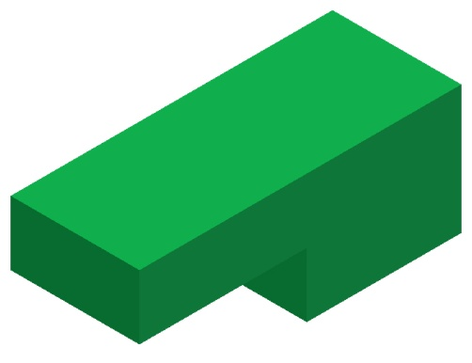
Projection of a normal line
Glass box concept
Multiview drawing
B_{T}
B_{T}
A_{T}
B
A_{T}
A
B_{R}
A_{F}
A_{F}
B_{F}
A_{R}
B_{R}
B_{F}
A_{R}
Play

Slide 44
Projection of a normal plane
Glass box concept
Multiview drawing
Play

Slide 45
Projection of an object
Glass box concept
Multiview drawing
Hidden line is used
to show existence of
a hidden edge.
Do the same procedures for
all remaining edges (or planes)
Play

Slide 46
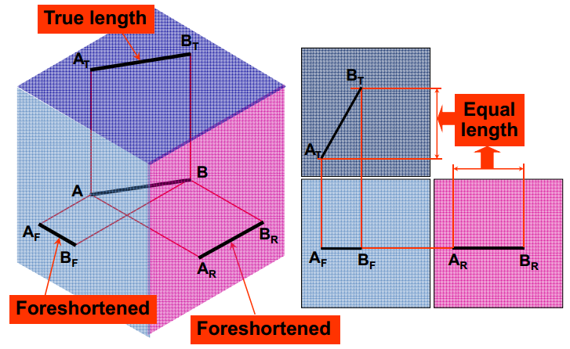
Projection of inclined line

Slide 47
Projection of an inclined line
Glass box concept
Multiview drawing
B_{T}
B_{T}
B
A_{T}
B_{R}
B_{F}
A_{T}
B_{F}
B_{R}
A
A_{F}
A_{R}
A_{F}
A_{R}
Play

Slide 48
Projection of an inclined plane
Glass box concept
Multiview drawing
Play

Slide 49
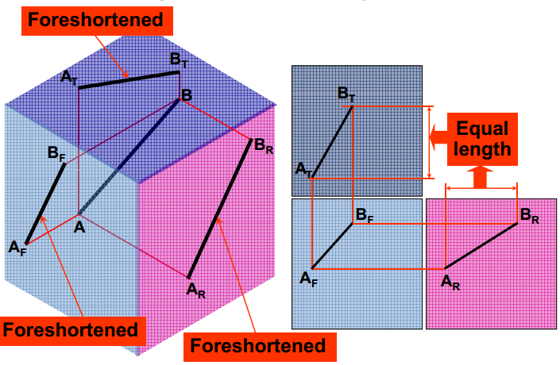
Projection of oblique line

Slide 50
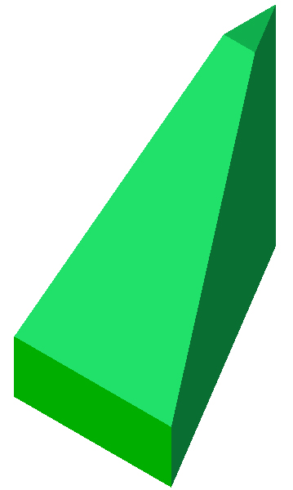
Projection of an obliqued line
Glass box concept
Multiview drawing
B_{T}
B_{T}
A_{T}
B
B_{R}
A_{T}
B_{F}
B_{R}
B_{F}
A
A_{F}
A_{R}
A_{F}
A_{R}
Play

Slide 51
Projection of an obliqued plane
Glass box concept
Multiview drawing
Play

Slide 52
Projection of a curve line
Glass box concept
Multiview drawing
B_{T}
B_{T}
A_{T}
C_{T}
C_{T}
B
A_{T}
A
B_{R}
C
A_{F}
C_{R}
B_{F}
A_{R}
A_{F}
B_{F}
C_{F}
A_{R}
C_{R}
B_{R}
C_{F}
Play

Slide 53
Projection of a curve surface
Glass box concept
Multiview drawing
Play

Slide 55
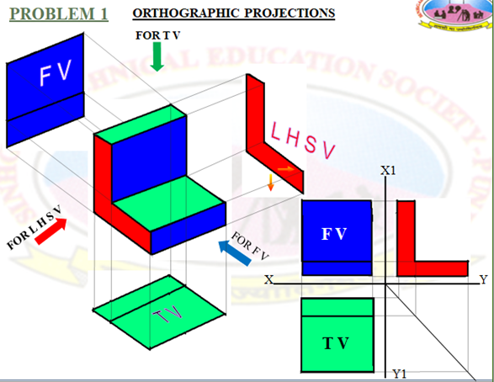

Slide 56
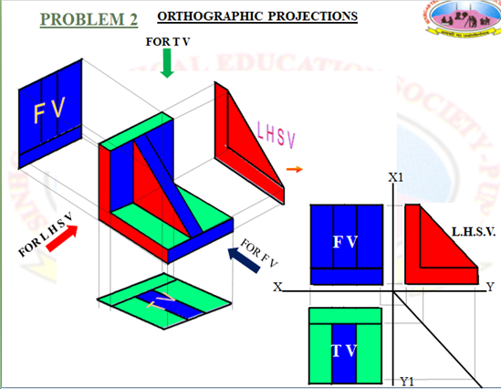

Slide 57
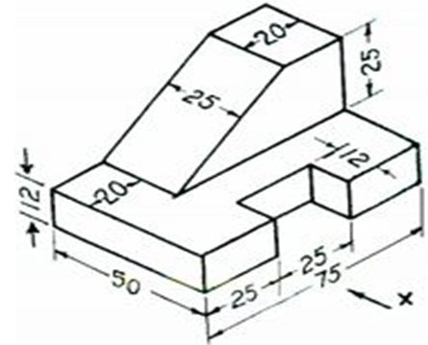

Slide 58
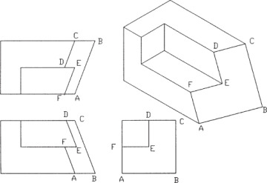

Slide 60
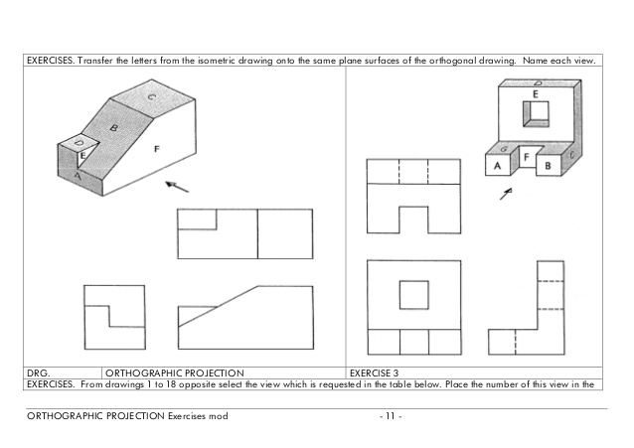

Slide 61
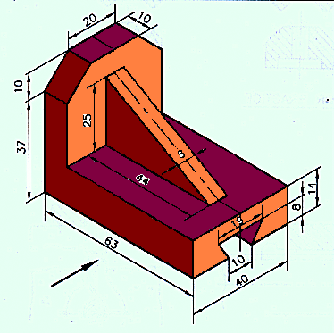
X

Slide 62
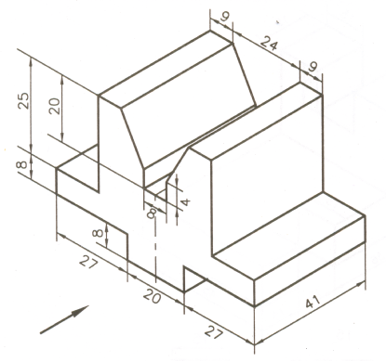
X

Slide 63
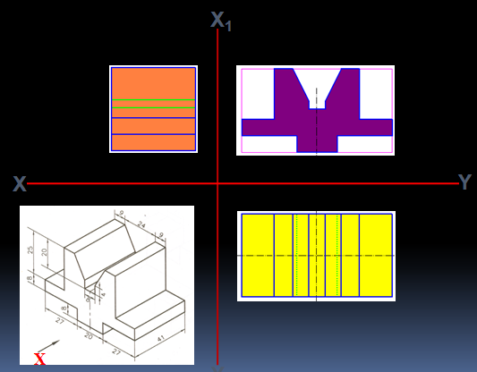

Slide 64
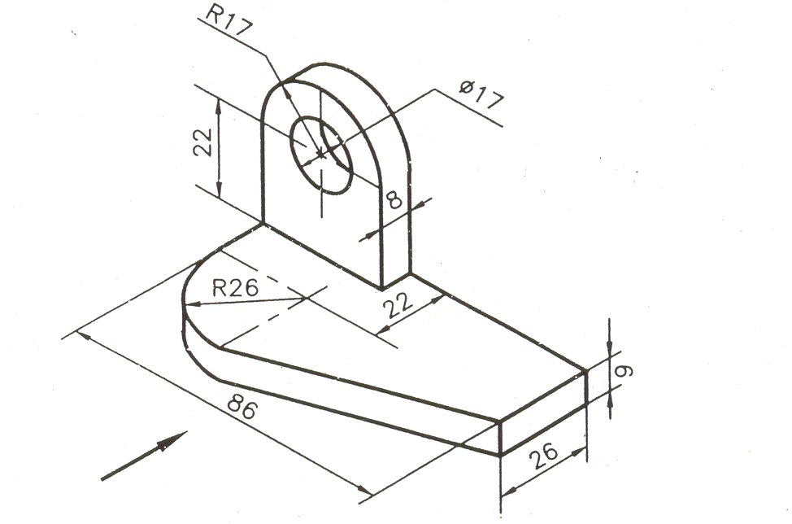

Slide 65
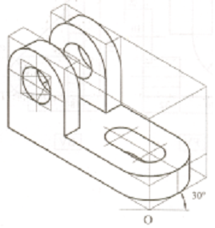

Slide 66
THE END!!

